Slide 1
Authentication Applications

Slide 2
Authentication Applications
will consider authentication functions
developed to support application-level authentication & digital signatures
will consider Kerberos – a private-key authentication service
then X.509 directory authentication service

Slide 3
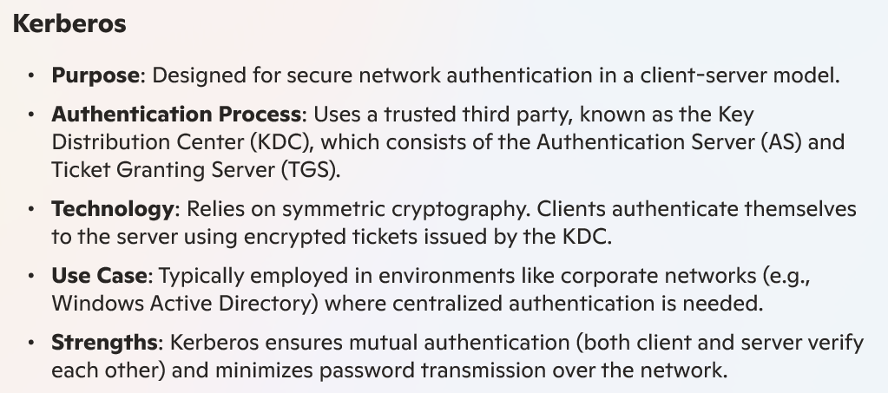


Slide 4
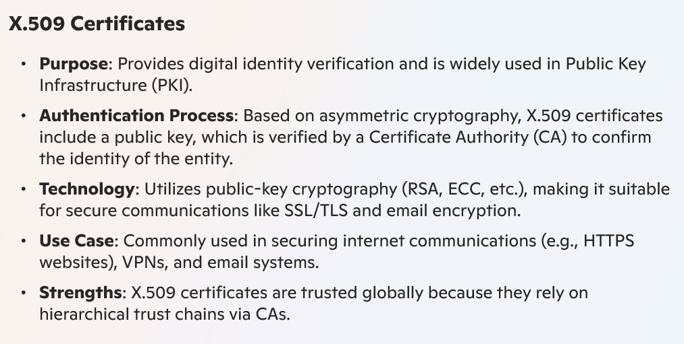

Slide 5
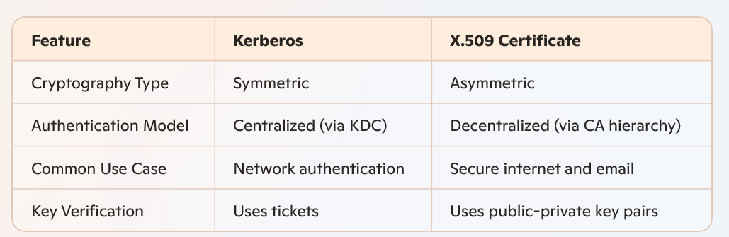

Slide 6
Kerberos
trusted key server system from MIT
provides centralised private-key third-party authentication in a distributed network
  allows users access to services distributed through network
  without needing to trust all workstations
  rather all trust a central authentication server
two versions in use: 4 & 5
Notes:
One of the best known and most widely implemented trusted third party key distribution systems. It was developed as part of Project Athena at MIT.

Slide 7
Kerberos
Kerberos provides a centralized authentication server whose function is to authenticate users to servers and servers to users.

Slide 8
Kerberos 4 Overview
a basic third-party authentication scheme
have an Authentication Server (AS)
  users initially negotiate with AS to identify self
  AS provides a non-corruptible authentication credential (ticket granting ticket TGT)
have a Ticket Granting server (TGS)
  users subsequently request access to other services from TGS on basis of users TGT
Notes:
The core of Kerberos is the Authentication and Ticket Granting Servers – these are trusted by all users and servers and must be securely administered.

Slide 9
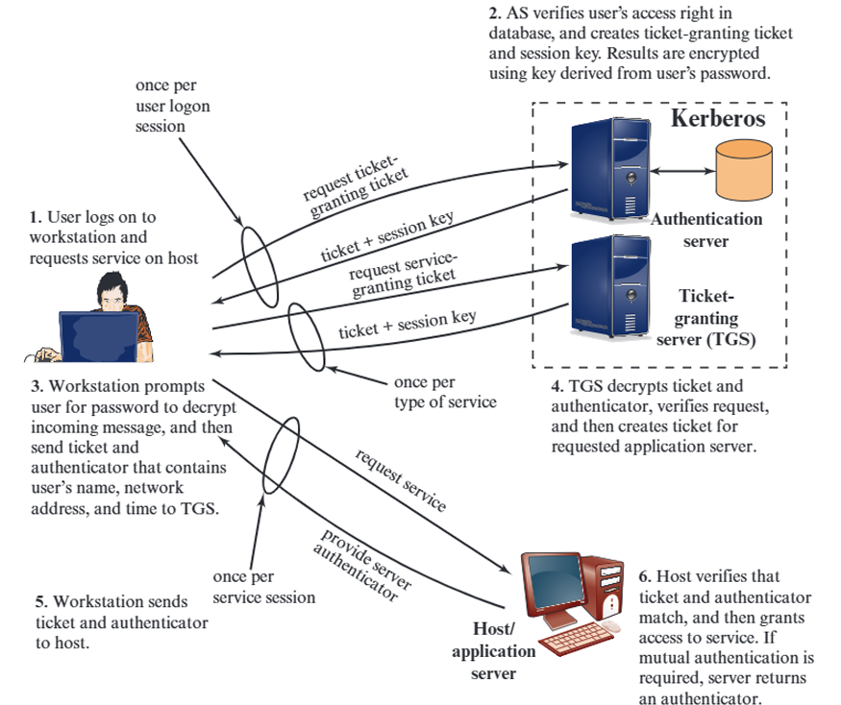

Slide 10
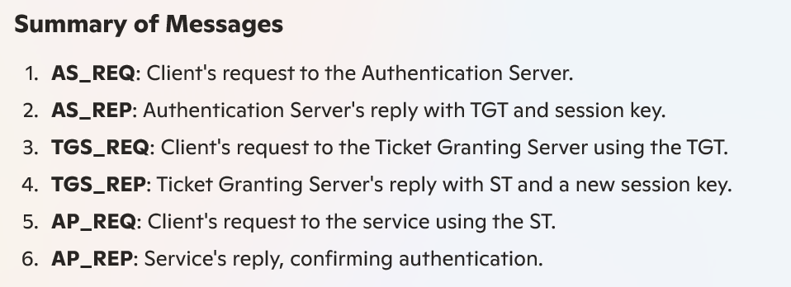
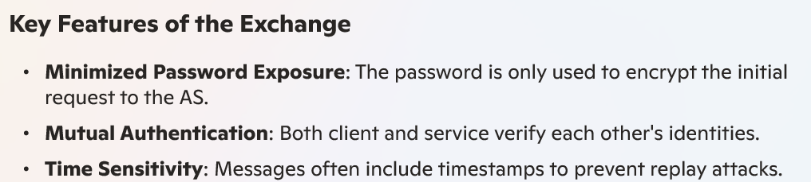

Slide 11
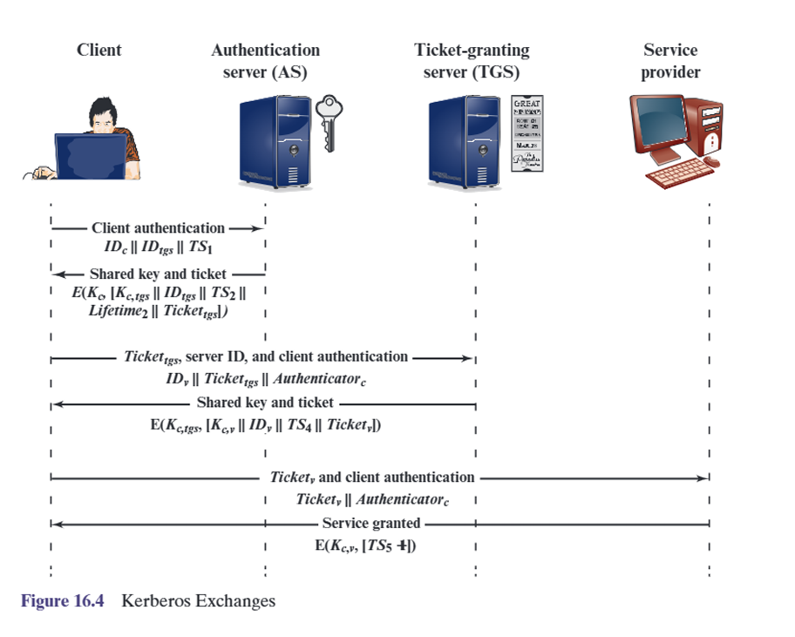

Slide 12
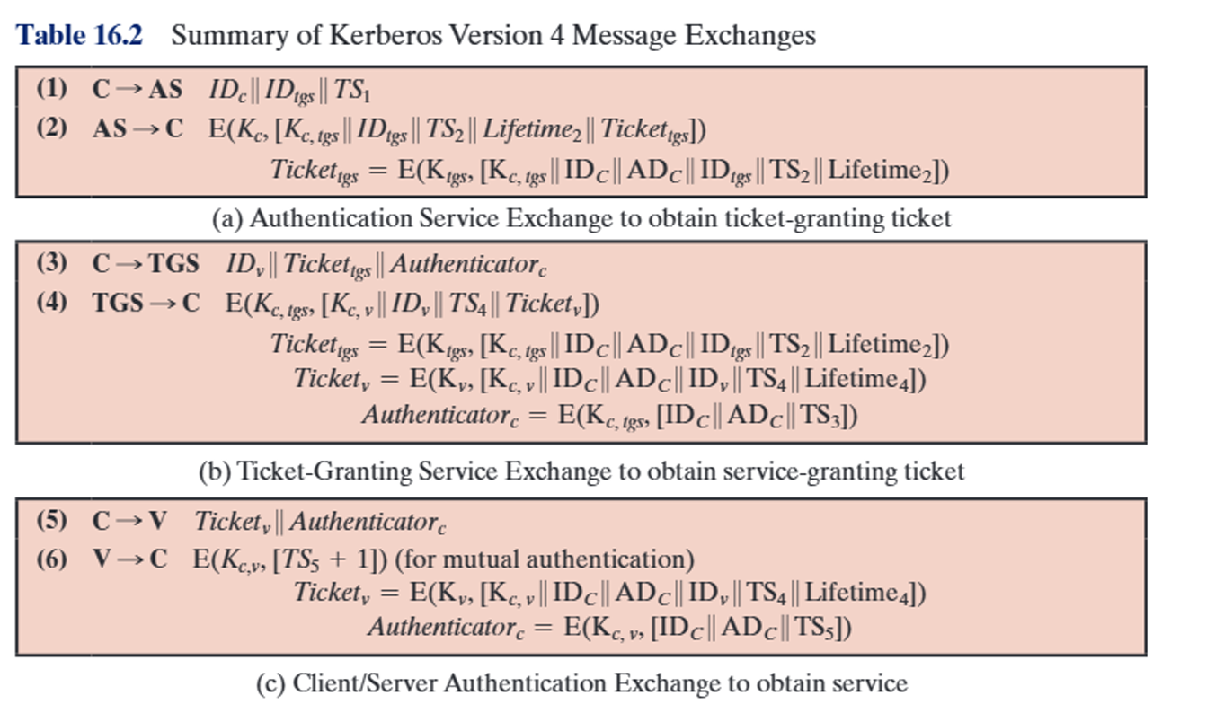

Slide 13
Kerberos Realms
a Kerberos environment consists of:
  a Kerberos server
  a number of clients, all registered with server
  application servers, sharing keys with server
this is termed a realm
  typically a single administrative domain
if have multiple realms, their Kerberos servers must share keys and trust

Slide 14
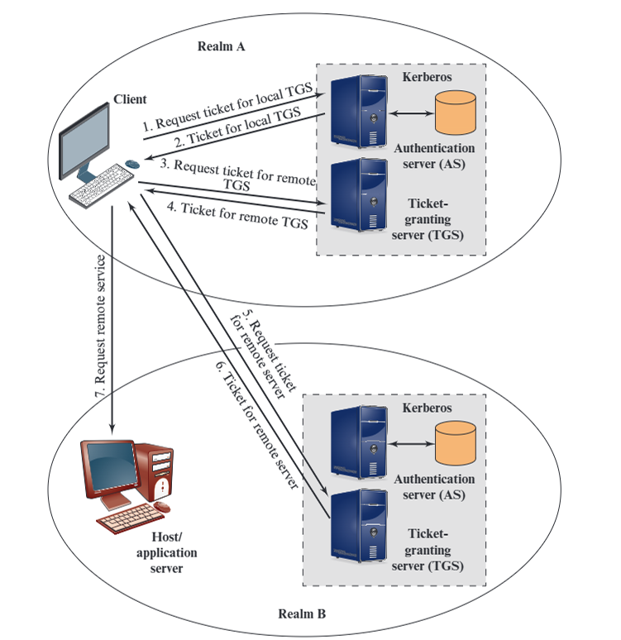

Slide 15
Kerberos Version 5
developed in mid 1990’s
provides improvements over v4
  addresses environmental shortcomings
    encryption alg, network protocol, byte order, ticket lifetime, authentication forwarding, interrealm auth
  and technical deficiencies
    double encryption, non-std mode of use, session keys, password attacks
specified as Internet standard RFC 1510

Slide 16
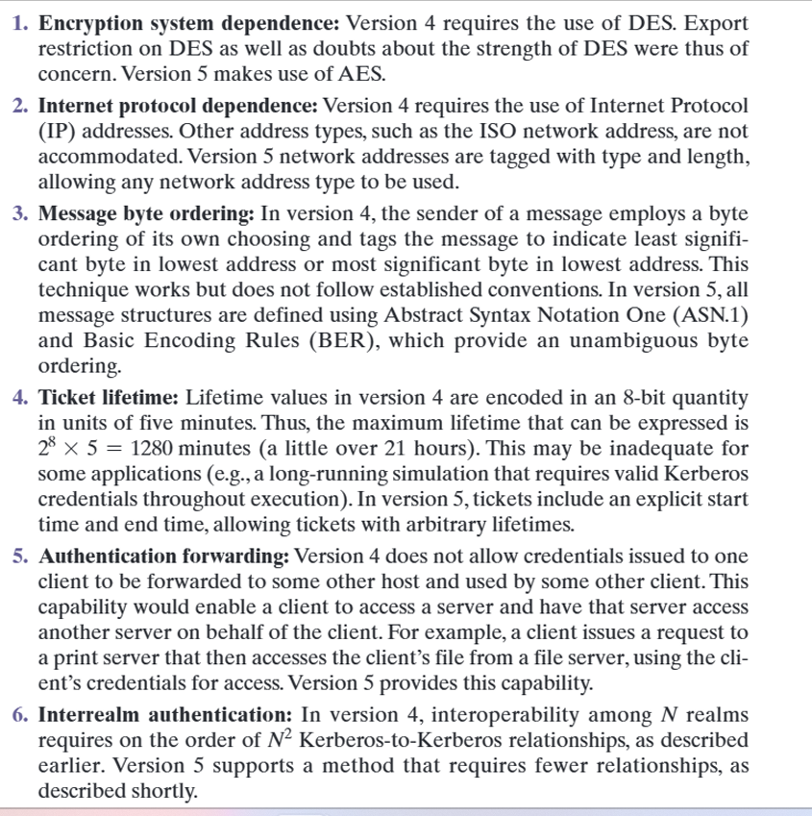
Kerberos V4 and V5

Slide 17
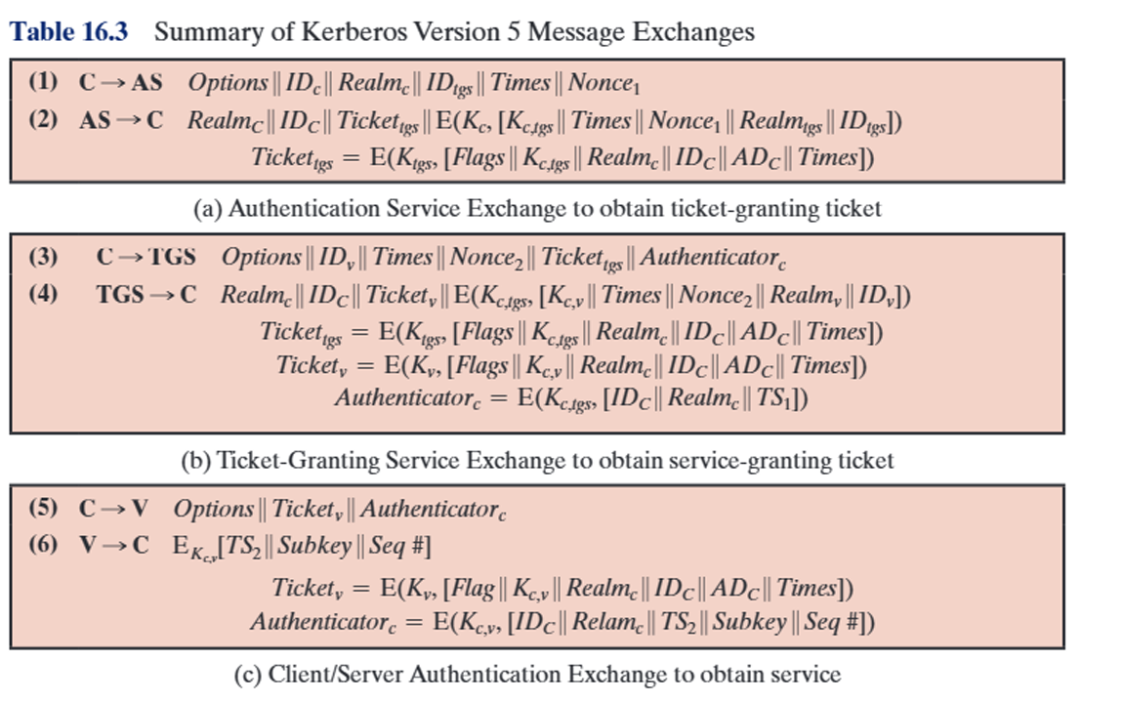

Slide 18
X.509 Authentication Service
part of CCITT X.500 directory service standards
  distributed servers maintaining some info database
defines framework for authentication services
  directory may store public-key certificates
  with public key of user
  signed by certification authority
also defines authentication protocols
uses public-key crypto & digital signatures
  algorithms not standardised, but RSA recommended
Notes:
X.509 is the Internationally accepted standard for how to construct a public key certificate, and is becoming widely used. It has gone through several versions. It is used by S/MIME secure email, SSL/TLS secure Internet links (eg for secure web).

Slide 19
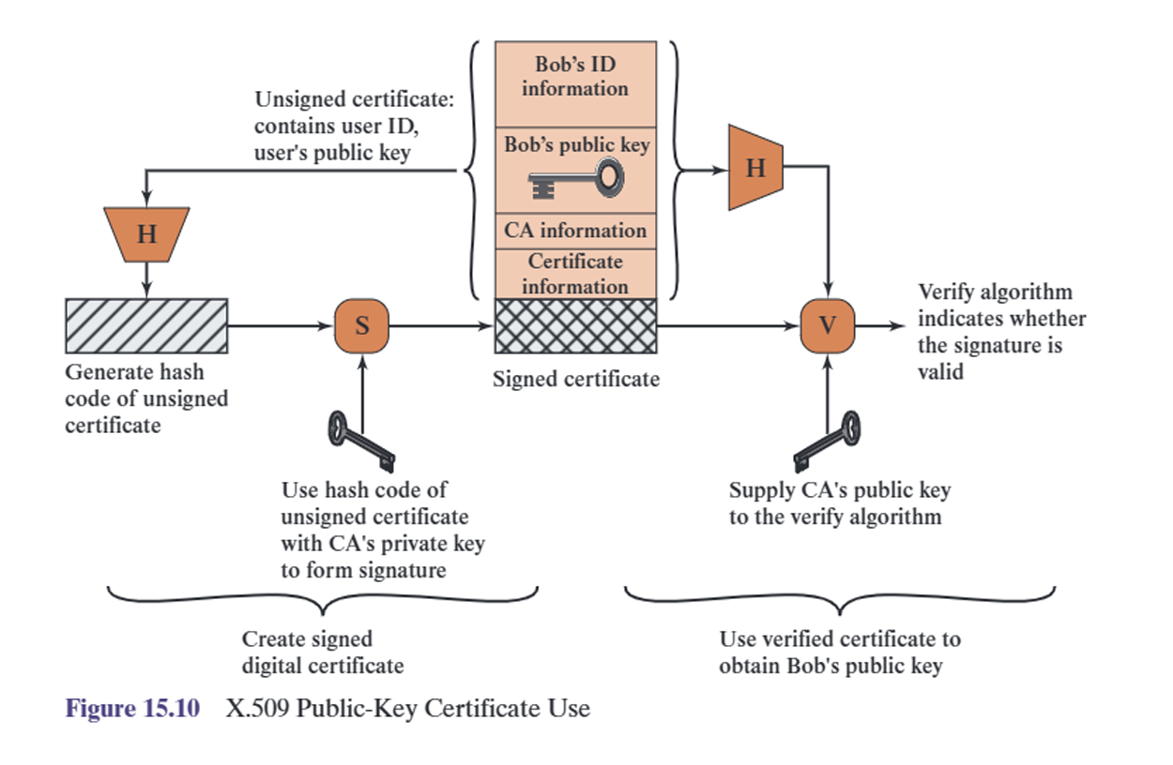

Slide 20
X.509 Certificates
issued by a Certification Authority (CA), containing:
  version (1, 2, or 3)
  serial number (unique within CA) identifying certificate
  signature algorithm identifier
  issuer X.500 name (CA)
  period of validity (from - to dates)
  subject X.500 name (name of owner)
  subject public-key info (algorithm, parameters, key)
  issuer unique identifier (v2+)
  subject unique identifier (v2+)
  extension fields (v3)
  signature (of hash of all fields in certificate)
notation CA<<A>> denotes certificate for A signed by CA
Notes:
The X.509 certificate is the heart of the standard. There are 3 versions, with successively more info in the certificate - must be v2 if either unique identifier field exists, must be v3 if any extensions are used.

Slide 21
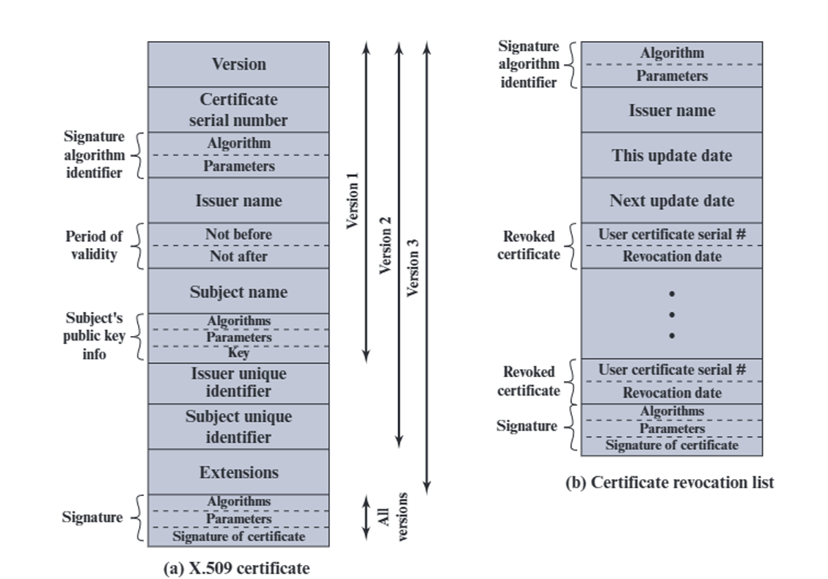
X.509 Certificates
Notes:
Stallings Fig 14.3

Slide 22
Obtaining a Certificate
any user with access to CA can get any certificate from it
only the CA can modify a certificate
because cannot be forged, certificates can be placed in a public directory

Slide 23
CA Hierarchy
if both users share a common CA then they are assumed to know its public key
otherwise CA's must form a hierarchy
use certificates linking members of hierarchy to validate other CA's
  each CA has certificates for clients (forward) and parent (backward)
each client trusts parents certificates
enable verification of any certificate from one CA by users of all other CAs in hierarchy
Notes:
All very easy is both parties use the same CA. If not, then there has to be some means to form a chain of certifications between the CA's used by the two parties. And that raises issues about whether the CA's are equivalent, whether they used the same policies to generate their certificates, and how much you're going to trust a CA at some remove from your own. These are all open issues.

Slide 24
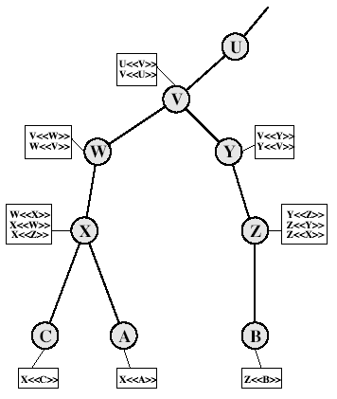
CA Hierarchy Use
Notes:
Stallings Fig 14.4.
Track chains of certificates:
A acquires B certificate using chain: X<<W>>W<<V>>V<<Y>>Y<<Z>>Z<<B>>
B acquires A certificate using chain: Z<<Y>>Y<<V>>V<<W>>W<<X>>X<<A>>

Slide 25
Certificate Revocation
certificates have a period of validity
may need to revoke before expiry, eg:
  user's private key is compromised
  user is no longer certified by this CA
  CA's certificate is compromised
CA’s maintain list of revoked certificates
  the Certificate Revocation List (CRL)
users should check certs with CA’s CRL

Slide 26
Authentication Procedures
X.509 includes three alternative authentication procedures:
One-Way Authentication
Two-Way Authentication
Three-Way Authentication
all use public-key signatures
Notes:
The X.509 standard specifies the authentication protocols that can be used when obtaining and using certificates. 1-way for unidirectional messages (like email), 2-way for interactive sessions when timestamps are used, 3-way for interactive sessions with no need for timestamps (and hence synchronised clocks).

Slide 27
One-Way Authentication
1 message ( A->B) used to establish
  the identity of A and that message is from A
  message was intended for B
  integrity & originality of message
message must include timestamp, nonce, B's identity and is signed by A

Slide 28
Two-Way Authentication
2 messages (A->B, B->A) which also establishes in addition:
  the identity of B and that reply is from B
  that reply is intended for A
  integrity & originality of reply
reply includes original nonce from A, also timestamp and nonce from B

Slide 29
Three-Way Authentication
3 messages (A->B, B->A, A->B) which enables above authentication without synchronized clocks
has reply from A back to B containing signed copy of nonce from B
means that timestamps need not be checked or relied upon

Slide 30
X.509 Version 3
has been recognised that additional information is needed in a certificate
  email/URL, policy details, usage constraints
rather than explicitly naming new fields defined a general extension method
extensions consist of:
  extension identifier
  criticality indicator
  extension value

Slide 31
Certificate Extensions
key and policy information
  convey info about subject & issuer keys, plus indicators of certificate policy
certificate subject and issuer attributes
  support alternative names, in alternative formats for certificate subject and/or issuer
certificate path constraints
  allow constraints on use of certificates by other CA’s

Slide 32
Summary
have considered:
  Kerberos trusted key server system
  X.509 authentication and certificates

